Slide 1
Cellular Networks – Part 2

Slide 2
Agenda
Cellular Architecture
Wireless Generations

Slide 3
CELLULAR ARCHITECTURE

Slide 4
Cellular Architecture Terminology
MT: Mobile terminal (station)
BS: base station
MSC: Mobile switch center
PSTN: Public Switched Telephone Network
AuC: Authentication Center
EIR: Equipment Identity Register
SS7: Signaling System 7 protocol
STP: Signal Transfer Point
HLR: Home Location Register
VLR: Visitor Location Register
RA: Registration Area
IMEI: International Mobile Equipment Identity number.

Slide 5
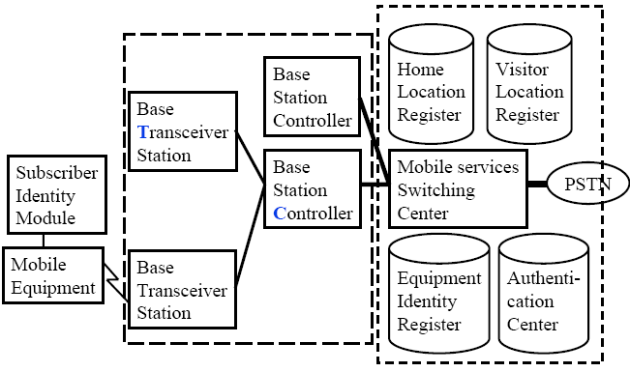
Cellular Architecture
Mobile Station Base Station Subsystem Network Subsystem

Slide 6
Cellular Architecture
Base station consists of Base station controller (BSC) and Base transceiver station (BTS)
One BTS per cell.
One BSC can control multiple BTS.
Allocates radio channels among BTSs.
Manages call handoffs between BTSs.
Controls handset power levels
Mobile Switching Center (MSC)
Connects to PSTN and switches calls between BSCs.
Provides mobile registration, location, authentication.

Slide 7
Cellular Architecture
Home Location Register (HLR) and Visitor Location Register (VLR) provide call routing and roaming
Equipment Identity Register (EIR) contains a list of all valid mobiles.
Authentication Center (AuC) stores the secret keys of all SIM cards.
Each handset has a International Mobile Equipment Identity (IMEI) number. (15 digit code *#06#) Used to identify valid devices in GSM

Slide 8
WIRELESS GENERATIONS

Slide 9
Cellular Network Generations
It is useful to think of cellular Network/telephony in terms of generations:
0G: Briefcase-size mobile radio telephones
1G: Analog cellular telephony
2G: Digital cellular telephony
3G: High-speed digital cellular telephony (including video telephony)
4G: IP-based “anytime, anywhere” voice, data, and multimedia telephony at faster data rates than 3G

Slide 10
Wireless Generations Acronyms
Advanced Mobile Phone System (AMPS)
Total Access Communication System (TACS)
Interim Standard (IS) from Electronic Industry Association (EIA)/Telecommunications Industry Association (TIA)
Digital Advanced Mobile Phone System (D-AMPS)
Global system for mobile communication (GSM)
Digital Communication Network (DCN)
North America (NA)
Frequency/Time/Code division multiple access (FDMA/TDMA/CDMA)

Slide 11
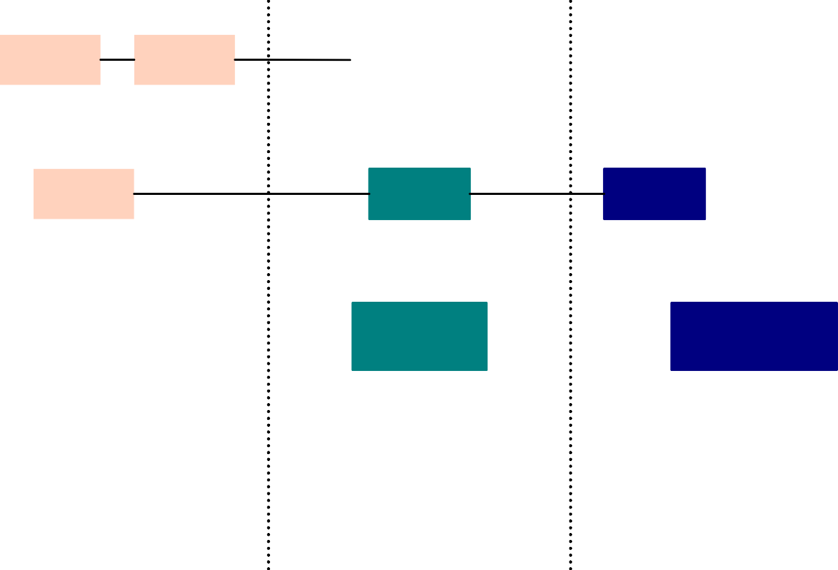
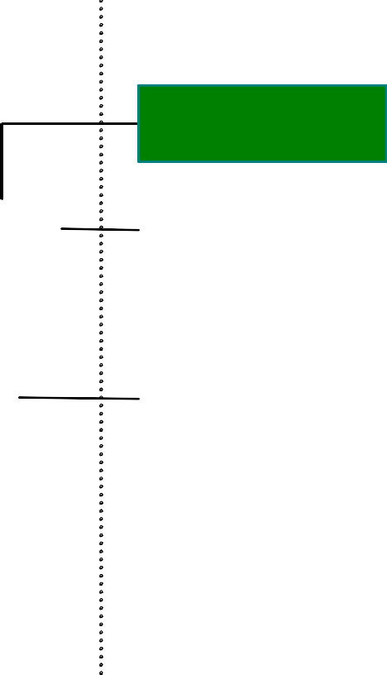
Wireless System Evolution: Cellular Networks
AMPS IS-41
USDC IS-136
CDPD
TD-SCDMA
ETACS
GSM
GPRS
EDGE
UMTS WCDMA
(3GPP)
CDMA IS-95
CDMAone
IS-95B
CDMA 2000 1X, 3X (3GPP2)
1G
2G
2.5G 3G
AMPS ETACS
Advanced Mobile Phone System European Total Access Communication System
United States Digital Cellular
Global Systems for Mobile Cellular Cellular Digital Packet Data
GPRS EDGE
General Packet Radio Service
Enhanced Data Rates for GSM Evolution
USDC GSM CDPD
UMTS 3GPP
Universal Mobile Telecommunications System 3rd Generation Partnership Project
TD-SCDMA
Time Division Synchronous Code Division Multiple Access

Slide 12
1G Wireless Systems
Appeared in late 1970s and deployed in early 1980s.
All based on analog techniques, all used FDMA and FM modulation.
System capacity is low. Data rate: 8~10 kbps
Representative Standards:
AMPS: Advanced Mobile Phone System, developed by AT&T Bell Labs in late 1970s. First deployed in 1983. The first AMPS system used large cells and omni-directional base station antennas, therefore, the number of users that can be supported was quite limited. AMPS is used all over the world and is esp. popular in US, South America, China and Australia. (30kHz channel)
ETACS: European Total Access Communication Systems. Almost identical to AMPS except that the channel bandwidth is scaled to 25kHz instead of 30 kHz as in AMPS.

Slide 13
1st Generation Cellular Mobile System
1983 US Advanced Mobile Phone Service AMPS
Developed by AT&T late 1970
Analog modulation, Operating at 800 MHz band used a total of 40 MHz bandwidth
Channels spaced 30 kHz apart ⇒416 channels per operator
21 Control/paging/access, and 395 traffic channels
Cluster size N=7, S/I= 18 dB
1985 European Total Access Communication System ETACS
Developed in Europe/UK mid 1980
Operating at 900 MHz band used a total of 40 MHz bandwidth
Cluster size N=7, B_{c}=25 KHz/simplex FM voice channel, S/I= 18 dB

Slide 14
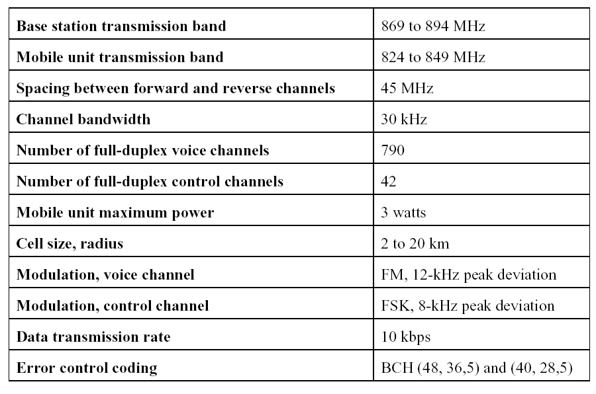
AMPS vs ETACS
AMPS ETACS
935-960 MHz B_{t} =25 MHz
890-915 MHz B_{t} =25 MHz
45 MHz
25 kHz
1000
-
- -
FM, +10 kHz
FM, +6.4 kHz
8 kbps
Data transmission rate on digital control channels
Notes:
BCH is an error correction code. Invented in 1959 and 1960 independently

Slide 15
Drawbacks of 1st Generation
No security
No encryption because analog signal do not allow efficient encryption
Inferior quality
Analog modulation is more susceptible to interference
No coding and error correction/detection techniques
Spectrum Inefficiency
A channel is allocated to a single user, whether user talks or not
In contrast, digital schemes…
Allow channel sharing through CDMA or TDMA
Allow data compression
Use error detection/correction

Slide 16
2G Wireless Systems: Characteristics
Deployed in mid 1990s, 2G wireless systems all use digital voice coding and digital modulation.
Can provide advanced call capabilities and at least a 3-times increase in overall system capacity.
Was designed before the widespread of the Internet, mainly supported voice-centric services and limited data-service, like short messages, FAX, etc...

Slide 17
2nd Generation Cellular Mobile System
Major Features for 2nd Generation systems:
FDMA/TDMA digital system
Minimum of 8 TDMA frames
Channel bandwidth < 200 kHz (8 x 25 kHz analog channels)
Maximum cell radius R : 35 km for high traffic in rural areas
Frequency region 900 MHz
Maximum mobile unit speed 250 km/hr = 69.4 m/s
Result (Many !!)
GSM: European Global System for Mobile Communications (TDMA/FDD)
IS-54, IS-136: US North American Standard (TDMA/FDD)
IS-95: US (CDMA)
D-APMS: Digital AMPS
PDC: Personal Data System Japan (TDMA/FDD)
PCS: Personal Communiaction System

Slide 18
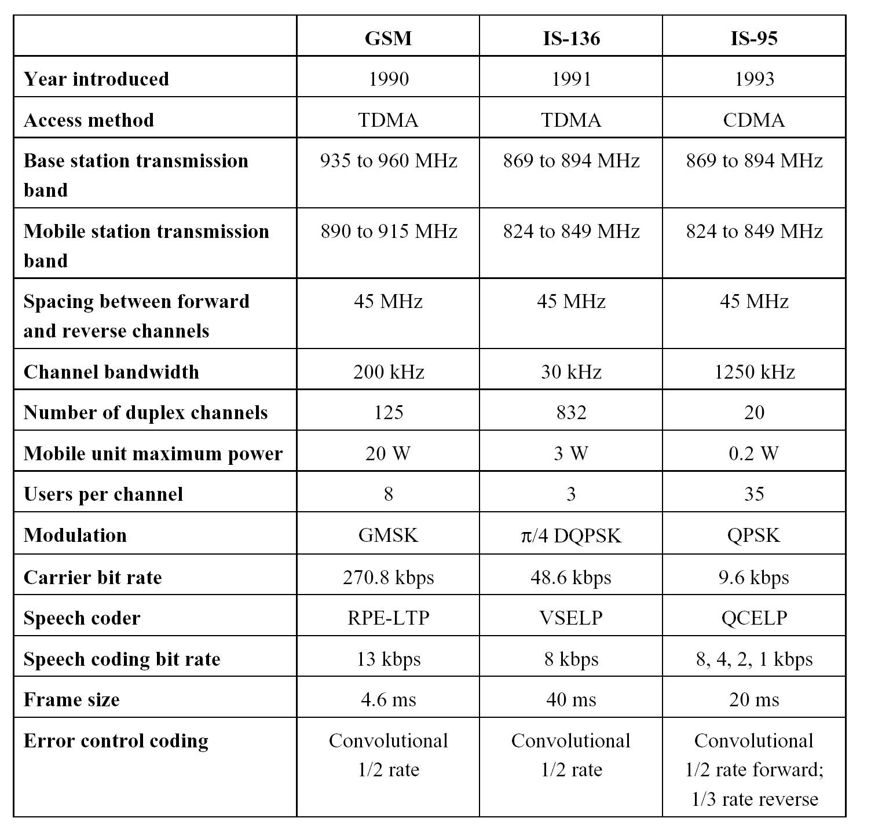
2nd Generation Cellular Mobile System

Slide 19
2G Wireless Systems: Representative Standards
GSM (Global Systems for Mobile communications)
A TDMA system, serves as the pan-European cellular service, provides a wide range of network service, including phone service, FAX, short message service. Support 24.7kbps data rate.
USDC IS-136 (United States Digital Cellular)
A TDMA system which is compatible with AMPS, it supports more users (6 times) with improved performance. It shares the same frequencies, frequency reuse plan and base stations as AMPS. Provides access to VPN, supports short messages. Support 48.6kbps data rate.
IS-95 (United States Digital Cellular Standard )
A CDMA standard also designed to be compatible with AMPS through using of CDMA/AMPS dual mode phones and base stations. Capacity is 8~10 times that of AMPS. Support 14.4kbps data rate.

Slide 20
GSM: GLOBAL SYSTEM FOR MOBILE COMMUNICATION

Slide 21
GSM
Global System for Mobile Communication (GSM)
1982: Started as "Group Special Mobile" by Conference of European Posts and Telecom (CEPT)
Good speech quality, ISDN compatibility, and fraud secure.
Specs completed in 1990, Service began in 1992.
900 MHz operation in Europe.
UK allocated 1800 MHz and adapted GSM standard as Digital Communication Network "DCS/DCN 1800“
DCS 1800 also used in Russia and Germany.
USA FCC allocated 1900 MHz for PCS. Many carriers adapted GSM standard as "DCS 1900" or "North American GSM“
More than 280 GSM networks in 100 countries worldwide.

Slide 22
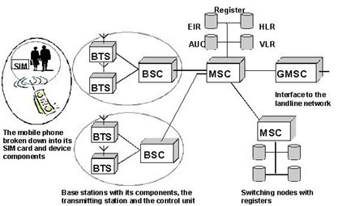
GSM Architecture

Slide 23
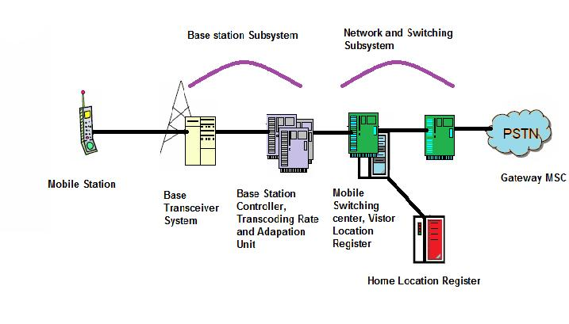
GSM Architecture

Slide 24
GSM The Physical Layer
FDM to separate uplink and downlink
Up Link: 890 – 915 MHz 25 MHz
Down link: 935 – 960 MHz 25 MHz
124 full duplex channels
200 KHz per channel per direction
Each channel is divided into 8 TDMA slots ⇒ Each slot acts like a logical channel.
Full rate channel may carry up to 13kbps speech or data at 12, 6, or 3.6 kb/s
Modulation used is GMSK (Gausian Minimum Shift Keying) modulation
Each channel divided into 8 slots
890 MHz
915 MHz
935 MHz
960 MHz
….
….
1
2
3
4
124
1
2
3
4
124
100
KHz
200
KHz
100
KHz
100
KHz
200
KHz
100
KHz
25 MHz
20MHz
25 MHz

Slide 25
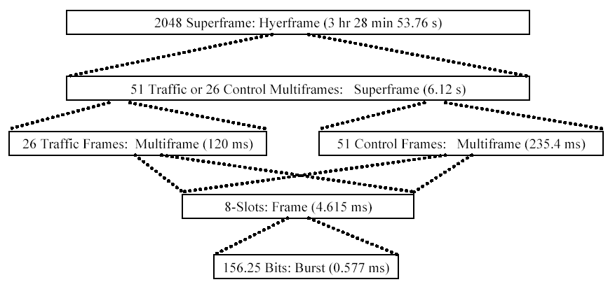
GSM Traffic Frame Hierarchy
Notes:
. A complete cycle of eight time slots is called a (TDMA) frame. Users cannot use all frames; for every 24 GSM frames that carry voice/data, one is "stolen" for signaling and another reserved for other types of traffic (such as short text messages or caller line identification). Thus eight slots make up a TDMframe and 26 TDM frames make up a multiframe. Multiframes are in turn grouped into superframes and hyperframes. Some of the slots here are used to hold several control channels for managing theGSM system

Slide 26
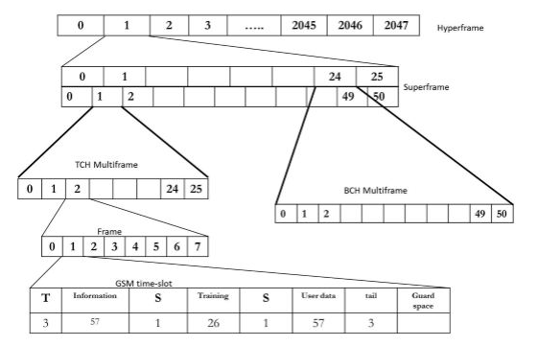
GSM Traffic Frame Hierarchy

Slide 27
GSM TDMA Slot Structure
Structure of a slot
3 tail bits: These tail bits at the start of the GSM burst give time for the transmitter to ramp up its power
26 bits Training Sequence used for timing reference and for equalisation
Flag bit: Identify whether slot carries payload or control
Two 57 data bits Payload/traffic: Voice or data plus error correction/detection codes
3 tail bits These final bits within the GSM burst are used to enable the transmitter power to ramp down. They are often called final tail bits, or just tail bits.
8.25 bits guard time At the end of the GSM burst there is a guard period. This is introduced to prevent transmitted bursts from different mobiles overlapping. As a result of their differing distances from the base station.

Slide 28
GSM Types of Control Channels
Broadcast Channel (BCH): Point to multipoint downlink
BCCH (broadcast control channel): send cell identities, organization info about common control channels, cell service available, etc
FCCH (frequency correction channel): send a frequency correction data burst to effect a constant frequency shift of RF carrier
SCH (synchronization channel): send TDMA frame number and base station identity code to synchronize MSs BCCH, FCCH, downlink by BTS
Common Control Channel (CCCH) for paging and access:
PCH (paging channel): to page any MT to alert it for an incoming call
AGCH (access grant channel): to assign MSs to stand-alone dedicated control channels for initial assignment
RACH (random access channel): for MS to send requests for call initiation
Dedicated Control Channel (DCCH), bi-directional point to point signaling between BTS and MS
Notes:
The control channels in GSM are classified into three broad categories. The broadcast control channel(BCCH) is a downlink channel that contains the BS's identity and channel status. All MTs monitor the BCCH to detect if they have moved into a new cell. The dedicated control channel (DCCH) is used for call-setup, location updates, and all call-management related information exchange. Every call has its own allotted DCCH. The information obtained on the DCCH is used by the BS to keep a record of all the MTs currently in its footprint (coverage area). The third category, common control channel(CCCH), consists of the downlink paging channel, which is used to page any MT to alert it for an incoming call, the random access channel, which supports slotted ALOHA-based (random request without reservation of time slot) request from MT to BS for call-initiation, and the access grant channel, on which the BS informs the MT of an allotted duplex channel for a call

Slide 29
GSM Data Services Why Voice Channel Not Good for Data?
Signal Distortion due to Speech encoding
Lossy encoding and compression due to redundancy on voice will corrupt the data
Handoff error: Delay in cell handoff ⇒ loss of data
Interface with PSTN
Non voice services are not indicated by PSTN network ⇒ cellular network has to find a way to differentiate between voice and data calls
A control message could be transmitted all along the path of the call, to indicate a data call so that voice coding can be disabled.
A two-stage dial-up operation can be used, first to the cellular carrier and then to the subscriber. The carrier has different numbers for each service it offers. For example, to set up a data call with an MT, the cellular carrier is first dialed, and it then informs the MT of a data call.
A subscriber could be assigned separate subscriber numbers for each service he/she opts for.

Slide 30
2.5 G

Slide 31
Data Services Over GSM 2.5G
Intended as a stop-gap until 3G comes
Compared to 2G systems, 2.5G systems enables high speed data communications, provides continuous connection to internet.

Slide 32
2.5G Wireless System
High Speed Circuit Switched Data HSCSD, first attempt data rates up to 115kbps
CDPD (Cellular Digital Packet Data), a data service for 1st and 2nd generation US cellular systems without additional bandwidth requirement, packet channels are dynamically assigned to idle voice channels. Support 19.2 kbps data rate.
GPRS (General Packet Radio Service), based on GSM by allowing multiple slots of a GSM radio channel be dedicated to an individual user, promises data rate from 56 kbps to 171.2 kbps--- continuous connection to the Internet for mobile phone and computer users, easy access to VPN (Virtual Private Network).
EDGE (Enhanced Data Rates for GSM Evolution), providing 384 kbps rate by using improved modulation (8-PSK instead of GMSK in GSM) and relaxed error control. Also referred to as EGPRS.
CDMA one (IS-95B): Providing high speed data access on a common CDMA radio channel by dedicating multiple orthogonal user channels for specific users or specific purposes. Support 115.2kbps.

Slide 33
Data Services Over GSM High-Speed Circuit Switched Data (HSCSD)
First attempt to get high-speed data over GSM
Allows data users to use the full TDMA Frame 1 to 8 slots
Data rates up to 115 kbps
Circuit switched ⇒ Constant data rate
Not suitable for bursty data
Not widely implemented
Main disadvantages
Increases blocking probability because subscriber occupies 8 logical channel
GPRS is more widely implemented

Slide 34
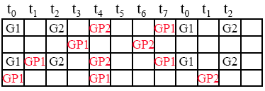
Data Services Over GSM General Packet Radio Service (GPRS)
Provide increased data rates based on Packet switching for data transmission
Standard GSM has 8 slots per 200 kHz channel ⇒one slot 22.8 kbps for uplink and downlink (data +error) which means data is 21.4kbps
GPRS allows any number of slots to a user
GMSK modulation 1 bit per sample
4 different codings CS1,.., CS4 used depending upon channel condition
9.05 kbps to 21.4 kbps per slot
76-171.2 kbps using all 8 slots.
Uplink 1
GPi : i^{th} GPRS user
Gi: i^{th} Voice User
Uplink 2
Downlink 1
Downlink 2

Slide 35
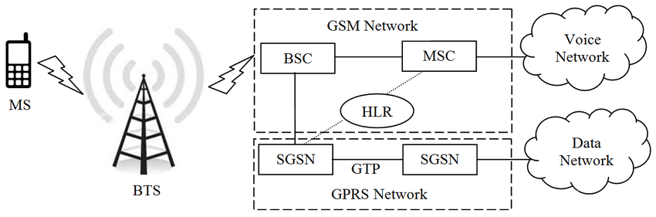
GPRS Architecture
GGSN
Service GPRS support node (SGSN)
Security, Mobility, Access control
Connects to HLR
Gateway GPRS support node (GGSN)
Connects to external packet switched networks (X.25 – TCP/IP)

Slide 36
Data Services Over GSM Enhanced Data Rates for GSM Evolution (EDGE)
Inherits everything from GSM and GPRS
Same infrastructure as GPRS with few software modifications
Same 8 slot per channel
Modulation adaptation (GMSK, 8-PSK) / Coding adaptation (for error detection)
Instead of the binary GMSK, it uses 8-PSK (octal PSK) modulation which triples the capacity compared to GSM ⇒ 3 bits/symbol in good channel condition
Theoretically Maximum data rate is 59.2 kbps/slot so maximum data rates is 473.6 kbps for 8 slots, practically download speed is 384kbps

Slide 37
3RD GENERATION

Slide 38
3rd Generation Cellular Mobile System
Goal: Provide high-speed packet based Voice and Data
The promise:
Virtual Home Environment: Uniform continuous presentation of services irrespective of location and access
Seamless global roaming: wireless access from anywhere on the earth, i.e. A single mobile world
Multiple-megabit internet services, very high data rates up to 2 Mbps
How to achieve
Effective and highly optimized architecture
Stringent adherence to QoS
Sophisticated algorithms for routing, handoff, location information retrieval, pricing,…, etc.

Slide 39
3G Wireless Systems: Representative Standards
3GPP UMTS (Universal Mobile Telecommunications System) [Europe], A wideband CDMA (5MHz, 25 times GSM) standard based on the network fundamentals of GSM/EDGE, is designed to provide backward compatibility with GSM, IS- 136, GPRS and EDGE. Can support 2Mbps data rate. New RF equipment needed.
3GPP2 CDMA 2000 3G 1X-3X [North America] Use one (same bandwidth as IS-95) or three adjacent 1.25MHz channels (3-times bandwidth as that of IS-95) to provide instantaneous packet data access at 144kbps or 2Mbps. No additional RF equipment needed, changes are all made in software or baseband hardware.
TD-SCDMA (Time-division Synchronous CDMA) [China] A standard proposed by CATT (China Academy and Telecommunications Technology) and Siemens Corporation. Relies on the existing GSM infrastructure and allows 3G data access by adding high data rate equipment (smart antennas) at each GSM station. Support up to 384kbps of packet data.

Slide 40
Problems with 3rd Generation systems
Need greater bandwidth and lower interference
Poor practical performance
In theory CDMA can support infinite users
In practice, disappointing performance
Not all Security problems are solved

Slide 41
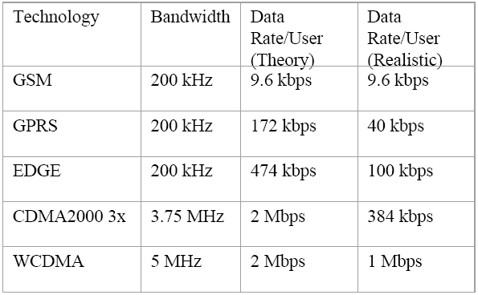
Data Rate Comparison

Slide 42
FOURTH GENERATION 4G

Slide 43

Fourth Generation

Slide 44
What is 4G?
Fourth Generation Technology
Faster and more reliable
100 Mb/s
Lower cost than previous generations
Multi-standard wireless system
IPv6 Core
OFDM used instead of CDMA
Potentially IEEE standard 802.11n
Most information is proprietary

Slide 45
4G
In the fourth-generation world of technology, there are two competing 4G standards:
Wireless interoperability microwave access (WiMAX)
Long-term evolution (LTE)
One difference between LTE and WiMAX is that they function on different frequencies, making their deployment slightly different. WiMAX™ is made to work with new deployments, while LTE™ is made for existing mobile and broadband deployments.
LTE is slightly faster and WiMAX is slightly easier to set up.
LTE is made to work on 700 megahertz (MHz), WiMAX is made to work on 2.3 gigahertz (GHz) and 3.5 GHz, and both are able to work on 2.1 GHz and 2.5 GHz.

Slide 46
4G (LTE)
LTE stands for Long Term Evolution
Next Generation mobile broadband technology
Promises data transfer rates of 100 Mbps
Based on UMTS 3G technology
Optimized for All-IP traffic

Slide 47
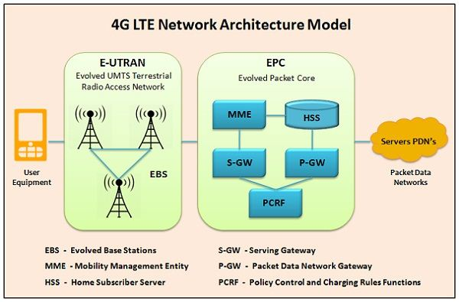
4G LTE Architecture

Slide 48
4G Components functions
eNB is a base station that controls the mobiles in one or more cells.
The Home Subscriber Server (HSS) component has been carried forward from UMTS and GSM and is a central database that contains information about all the network operator's subscribers.
The Packet Data Network (PDN) Gateway (P-GW) communicates with the outside world ie. packet data networks PDN.
The serving gateway (S-GW) acts as a router, and forwards data between the base station and the PDN gateway.
The mobility management entity (MME) controls the high-level operation of the mobile by means of signaling messages and Home Subscriber Server (HSS).
The Policy Control and Charging Rules Function (PCRF) is responsible for policy control decision-making, as well as for controlling the flow-based charging functionalities in the Policy Control Enforcement Function (PCEF), which resides in the P-GW.

Slide 49
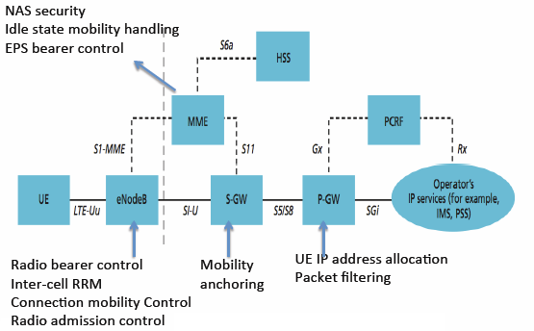
LTE Architecture

Slide 50
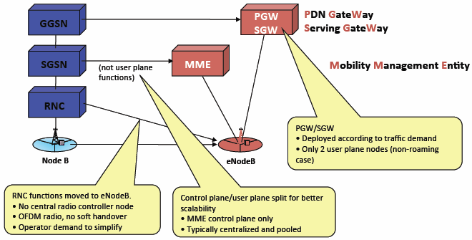
LTE vs 3G
Functional changes compared to the current 3G architecture

Slide 51
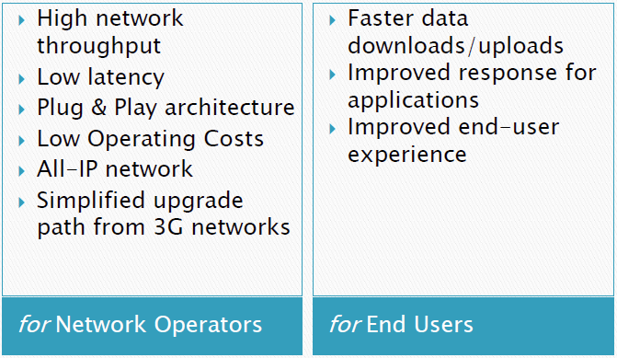
Advantages of LTE

Slide 52
Major LTE Radio Technologies
Uses Orthogonal Frequency Division Multiplexing (OFDM) for downlink
Uses Single Carrier Frequency Division Multiple Access (SC-FDMA) for uplink
Uses Multi-input Multi-output(MIMO) for enhanced throughput
Reduced power consumption
Higher RF power amplifier efficiency (less battery power used by handsets)

Slide 53
WiMAX 802.16
WiMAX systems are expected to deliver broadband access services to residential and enterprise customers in an economical way.
Loosely, WiMax is a standardized wireless version of Ethernet intended primarily as an alternative to wire technologies (such as Cable Modems, DSL and T1/E1 links) to provide broadband access to customer premises.
WiMAX is an industry trade organization formed by leading communications, component, and equipment companies to promote and certify compatibility and interoperability of broadband wireless access equipment that conforms to the IEEE 802.16 and ETSI HIPERMAN standards

Slide 54
WiMAX
Acronym for Worldwide Interoperability for Microwave Access.
Based on Wireless MAN technology.
A wireless technology optimized for the delivery of IP centric services over a wide area.
A scalable wireless platform for constructing alternative and complementary broadband networks.
A certification that denotes interoperability of equipment built to the IEEE 802.16 or compatible standard. The IEEE 802.16 Working Group develops standards that address two types of usage models −
A fixed usage model (IEEE 802.16-2004).
A portable usage model (IEEE 802.16e).

Slide 55
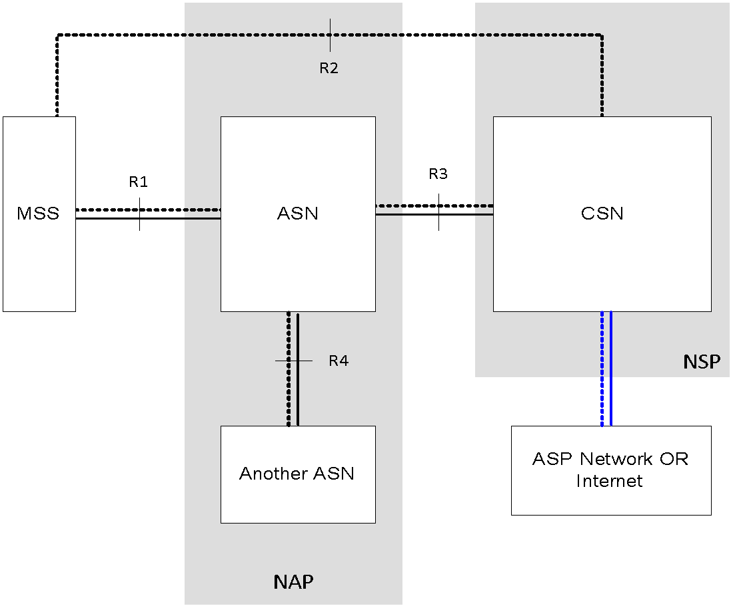
WiMAX Architecture
Access Service Network
Connectivity Service Network
Network Access Provider (NAP) owns the network and operations
Network Service Provider (NSP) owns the subscriber and provides service
Application Service Provider (ASP) provides application services

Slide 56
WiMAX Architecture
Access service network gateway (ASN-GW) −
The ASN gateway typically acts as a layer 2 traffic aggregation point within an ASN.
Additional functions include intra-ASN location management and paging, radio resource management, and admission control, caching of subscriber profiles, and encryption keys, AAA client functionality, establishment, and management of mobility tunnel with base stations, QoS and policy enforcement, foreign agent functionality for mobile IP, and routing to the selected CSN.
Connectivity service network (CSN) −
Provides connectivity to the Internet, ASP, other public networks, and corporate networks. The CSN is owned by the NSP and includes AAA servers that support authentication for the devices, users, and specific services.
Provides per user policy management of QoS and security.
Responsible for IP address management, support for roaming between different NSPs, location management between ASNs, and mobility and roaming between ASNs.

Slide 57
WiMAX BS architecture
OFDM
Modulation technique, spread spectrum
Used in e.g DSL, WLAN, WiMAX
MAC, control plane, user plane
Manage resources on the air interface
QoS
ARQ
Mobility Management
Radio Resource Management
Location
PHY
OFDM
MIMO
Modulation
P
H
Y
MAC
Data
Plane
MAC
Control
Plane
Service
Specific CS
e.g. IP

Slide 58
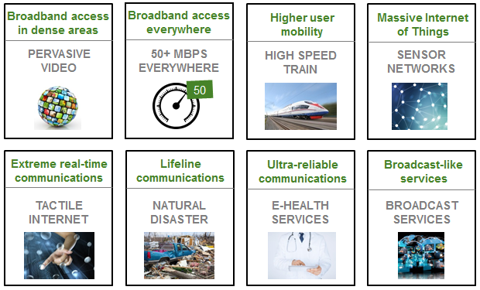
Starting point - ‘5G is different’
Service, application and business case-led definition

Slide 59
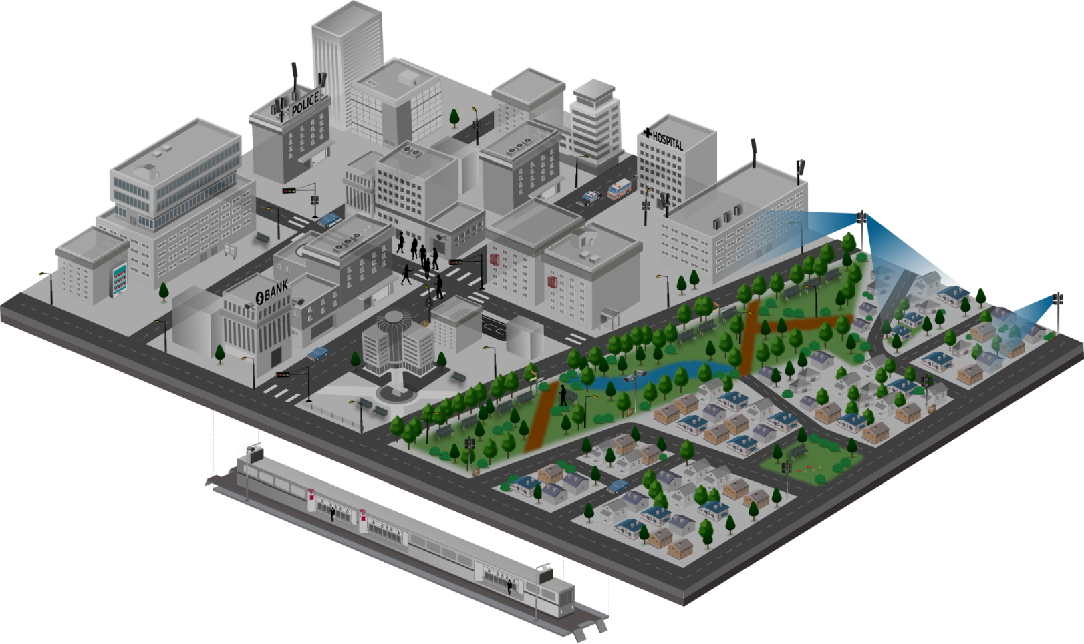












5G Service Scenarios
Key Scenarios to be Addressed throughout the Multiple Stages of 5G Development
1
4
Mission Critical Service
Fixed Broadband
· Next-generation broadband
· Multi-Gbps peak throughputs
· Alternative to costly fibre
· New VAS possibilities for
fresh revenue generation
Requirements
· Full reliability & high availability
· Real-time responsiveness
· On-the-fly coverage scalability
for disaster situations
Ambulance
10x bandwidth per connection
Low-ms latency
Five 9’s reliability
100% coverage
>10x connections
50Mbps per connection everywhere
1000x bandwidth/area
10 year battery life
Reduction in TCO
Autonomous driving
Vending machine
CCTV
CCTV
2
Massive IoT
3
· Connectivity for a new wave of device types
· High density deployments
· Networks-as-a-Service to meet
each service provider’s needs
· Robust QoE / QoS management
· New revenue opportunities
Mobile Broadband
CCTV
· Multi-Gbps peak throughputs
· Universal gigabit connectivity
· Unparalleled mobility support
· New service / application enablement
· Advanced big data analytics

Slide 60
Different contexts of the same environment
Requirements
Applications
Customer segments
MNO biz model
10x bandwidth per connection
Low-ms latency
Five 9’s reliability
100% coverage
>10x connections
50Mbps per connection everywhere
1000x bandwidth/area
10 year battery life
Reduction in TCO
Enhanced Mobile BB
Connected vehicles
AR/VR
S-UHD/3D Video
Haptics/Sensing
Massive IoT
Remote machine control
Mission critical services
Fixed-wireless access
…
Consumer
Auto industry
Health
Industry 4.0
Agriculture
Smart City/Public sector
Smart building
Utilities
Education
Transport
…
B2C
B2B
B2B2C

Slide 61


